Slide 1
Planning and Tracking
Prof. Dr. Dirk Riehle
Friedrich-Alexander University Erlangen-Nürnberg
AMOS D02
Licensed under CC BY 4.0 International
Notes:
It is Friedrich-Alexander University Erlangen-Nürnberg – FAU, in short.
Corporate identity wants us to say “Friedrich-Alexander University”.

Slide 2
Agenda
Planning horizons
Definition of done
Types of sprints
Sprint planning
Release planning
Roadmapping

Slide 3
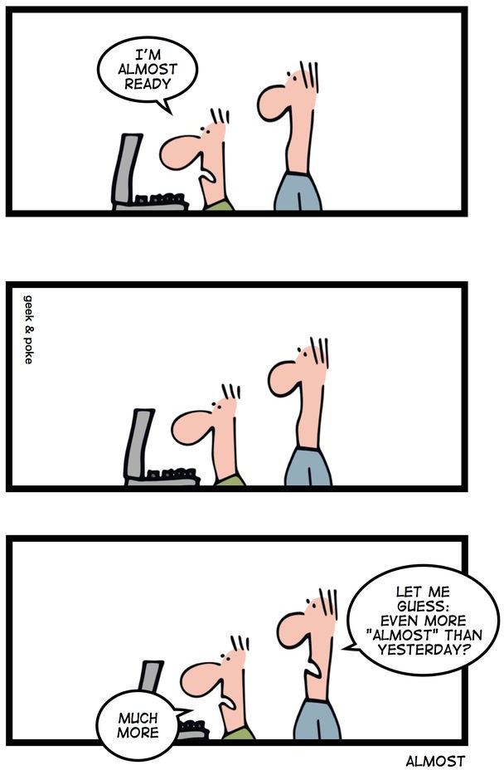

Slide 4
Cartoon Lesson
Software developers are optimists
Reliable prediction is difficult
You are always 80% there

Slide 5
1. Planning Horizons

Slide 6
Product Planning (Practices)
Roadmapping
Release planning
Sprint planning
Feature planning

Slide 7
Planning Horizons
...
...
Release 1.3
New functionality
Release 2.0
New architecture
Release 2.1
Major bug fixes
2014-04-01
2014-10-01
2015-04-01
time
...
Rel. m-1
Rel. m
Rel. m+1
...
6-12 months
6-12 months
6-12 months
time
Sprint n-1
Sprint n
Sprint n+1
...
...
P
E
3R
P
E
3R
P
E
3R
1-4 weeks
1-4 weeks
1-4 weeks
time

Slide 8
Relationship between Planning Horizons
A roadmap is a sequence of releases
  A roadmap can stretch over multiple years
A product release is a sequence of sprints
  A product release can take anything from 3-12 months or more
A sprint is a (short) time-box / iteration
  A sprint can be anything from 1-4 weeks

Slide 9
2. Definition of Done

Slide 10
Definition of Done (Artifact)
Definition of Done (DoD)
  An auditable check-list of results
  Built from value-adding activities
  That everyone previously agreed to
Other properties
  Should be orthogonal to acceptance criteria
  It is about the non-functional aspects of work

Slide 11
Definition of Done (Practices)
Agree on Definition of Done
  Responsible: Product owner, developers
  Artifacts: Definition of Done
  Collaborators: Same
Apply Definition of Done
  Responsible: Product owner, developers
  Artifacts: Definition of Done
  Collaborators: Same

Slide 12
Applicability of Definition of Done
Product Release
Sprint Release
Single Feature

Slide 13
Example DoD for Single Feature
Single feature DoD
  Unit tests for feature have been written and are passing
  Code review has been completed
  Feature branch has been tagged and merged
Always expected
  Project builds, deploys, and tests successfully
  Feature was demoed and accepted by product owner

Slide 14
Definition of Done vs. Acceptance Criteria
DoD (Feature)
  The same for every entry
Acceptance Criteria
  Specific to a backlog entry

Slide 15
3. Types of Sprints

Slide 16
Types of Sprints
Regular sprint
Exploratory sprint
Cleanup sprint
Release sprint

Slide 17
Start and Duration of Regular Sprints
Monthly Sprints
  Is original recommendation
  Is too long for some domains
  Should start 1st Monday
Two Week Sprints
  Are realistic even for beginners
  Align with half-month rhythm
  Should start on Wed or Thu
One Week Sprints
  Requires well-working team
  Are needed in some domains
  Should start on Wed or Thu

Slide 18
Irregular Sprints
...
P
E
3R
...
P
E
3R
Release
...
time
...
P
E
3R
...
Expo
...
time

Slide 19
Quiz: Working with Time 1 / 2
Your startup is selling designer clothes to consumers on the web. What sprint duration should you choose?
  1 week sprints
  4 week sprints
Your startup is selling cryptography software to enterprise customers. What sprint duration should you choose?
  1 week sprints
  4 week sprints

Slide 20
Quiz: Working with Time 2 / 2
Your consulting firm is hired to enhance a bank’s email software with a cryptography plug-in. Should you suggest a
  Defined scope but no deadline
  Project deadline (fixed release date)
You are coordinating the development of an open source multi-component JEE platform implementation. Should you release
  When a defined scope is reached
  When a defined date is reached

Slide 21
4. Sprint Planning

Slide 22
Sprint Planning 1 / 3 (Practices)
Prepare Sprint Planning Meeting
  Responsible: Product owner
  Artifacts: Features, product backlog
  Collaborators: Developers

Slide 23
Sprint Planning 2 / 3 (Practices)
Lead Sprint Planning Meeting
  Responsible: Product owner / Scrum master
  Artifact: Product and sprint backlog
  Collaborators: Developers
Explain Feature
  Responsible: Product owner
  Artifact: Feature
  Collaborators: Developers
Estimate Feature Size (a.k.a. Play Planning Poker)
  Responsible: Developers
  Artifact: Feature
  Collaborators: Product owner

Slide 24
Playing Planning Poker (Practice)
start
Product owner
picks feature
Each developer
deliberates
Developers re-
view total effort
Product owner
reads story
Each developer
plays card
no
Done?
yes
yes
end
Product owner
explains story
Agreement?
Product owner
adjusts backlog
no
Developers
discuss story

Slide 25
Sprint Planning 3 / 3 (Practices)
Manage Sprint Backlog
  Responsible: Product owner
  Artifacts: Features, product and sprint backlog
  Collaborators: Developers

Slide 26
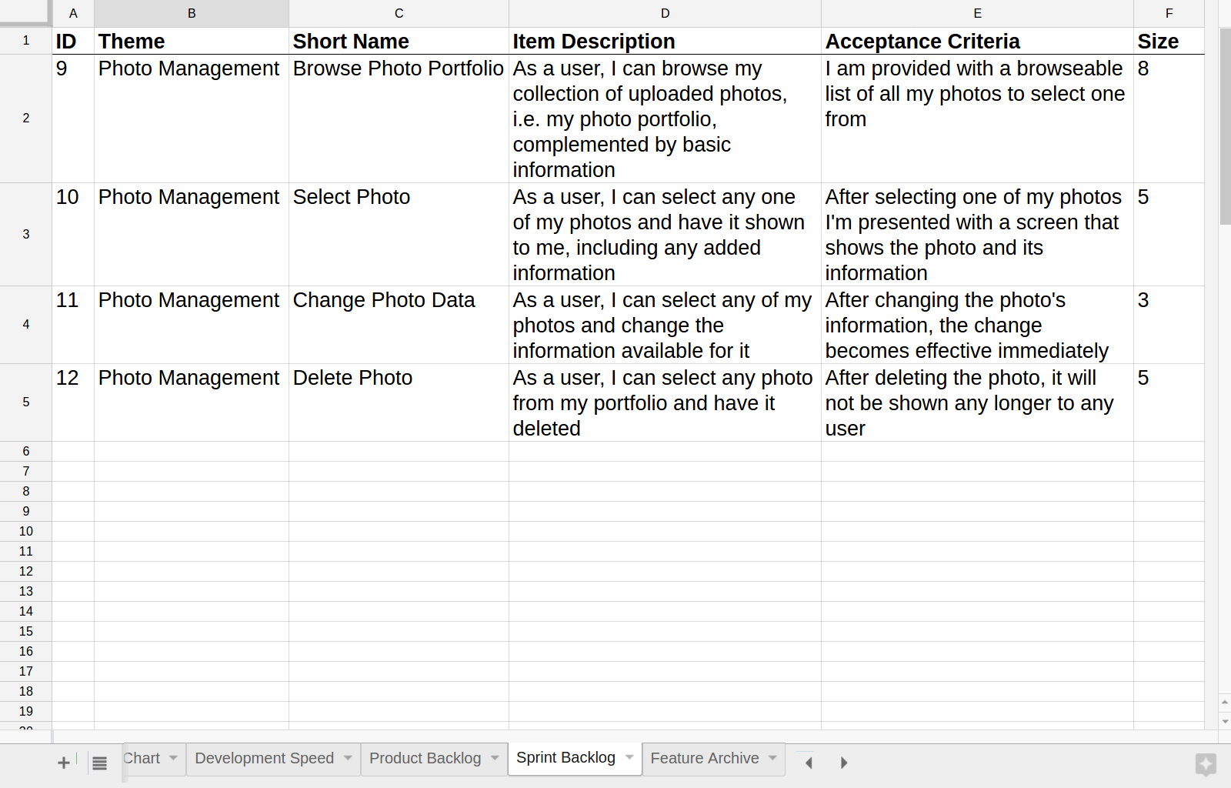
Sprint Backlog (Artifact)

Slide 27
Example DoD for Sprint Release
Sprint Release DoD
  Database consistency checks in test environment succeeded
Always expected
  Project builds, deploys, and tests successfully

Slide 28
Quiz: Sprint Planning
If a “user registration feature” is 8 story points, then a “user login feature” must be of size
  Less than 8 points
  Exactly 8 points
  More than 8 points
  Cannot determine

Slide 29
Development Speed (Velocity)
v = s / t
[ story points / sprint ]
v = speed (velocity)
s = size (of feature)
t = time (in sprints)

Slide 30
Track Development Speed (Practice)
Track Development Speed
  Responsible: Product owner
  Artifacts: Sprint backlog
  Collaborators: None

Slide 31
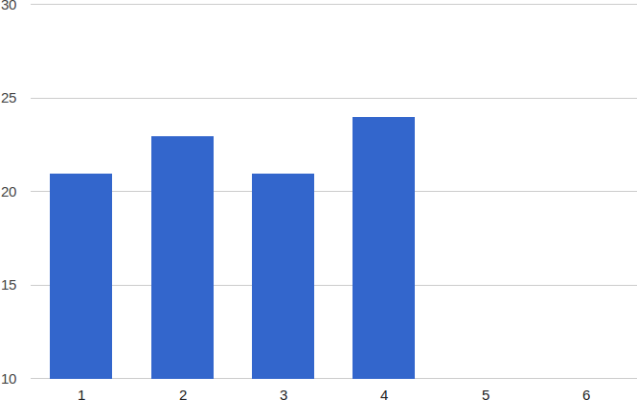
Development Speed Chart (Artifact)

Slide 32
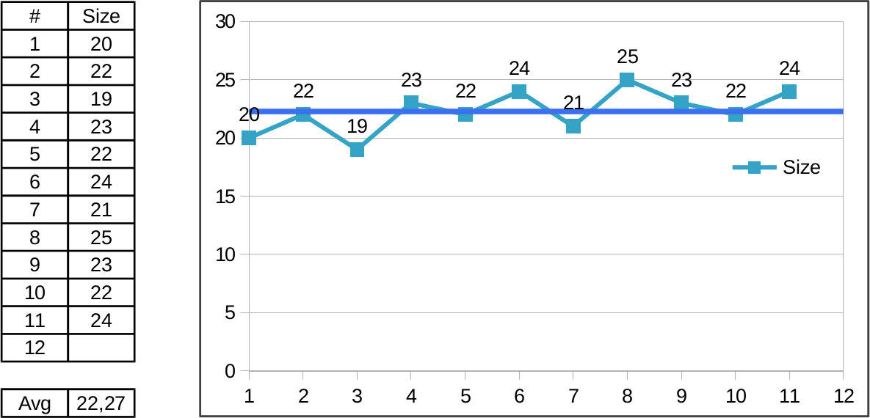
Working with Development Speed

Slide 33
Quiz: Progress Tracking
You are calculating development speed using a moving average of the last four sprints. Development speed fluctuates wildly. Possible reasons may be:
  The user stories are badly written
  The team is being distracted
  The code quality is poor
  All of the above

Slide 34
5. Release Planning

Slide 35
Release Planning (Practice)
Plan Releases
  Responsible: Product owner
  Artifacts: Release plan
  Collaborators: Market / customer, funder / sponsor
  Note: Not part of Scrum proper

Slide 36
Release Plan (Artifact)
Release Plan
  A sequence of releases with defined start and end times
  Where each release represents a deployable product increment
  That provides new significant business value to market / customer
  Note: Core of roadmap is captured as the release plan
Other properties
  Defined rhythm: Releases should be of about equal length in time
    Common are 3, 6, and 12 months increments
  External factors: Start and end dates are often determined by external factors
The release plan defines the release schedule

Slide 37
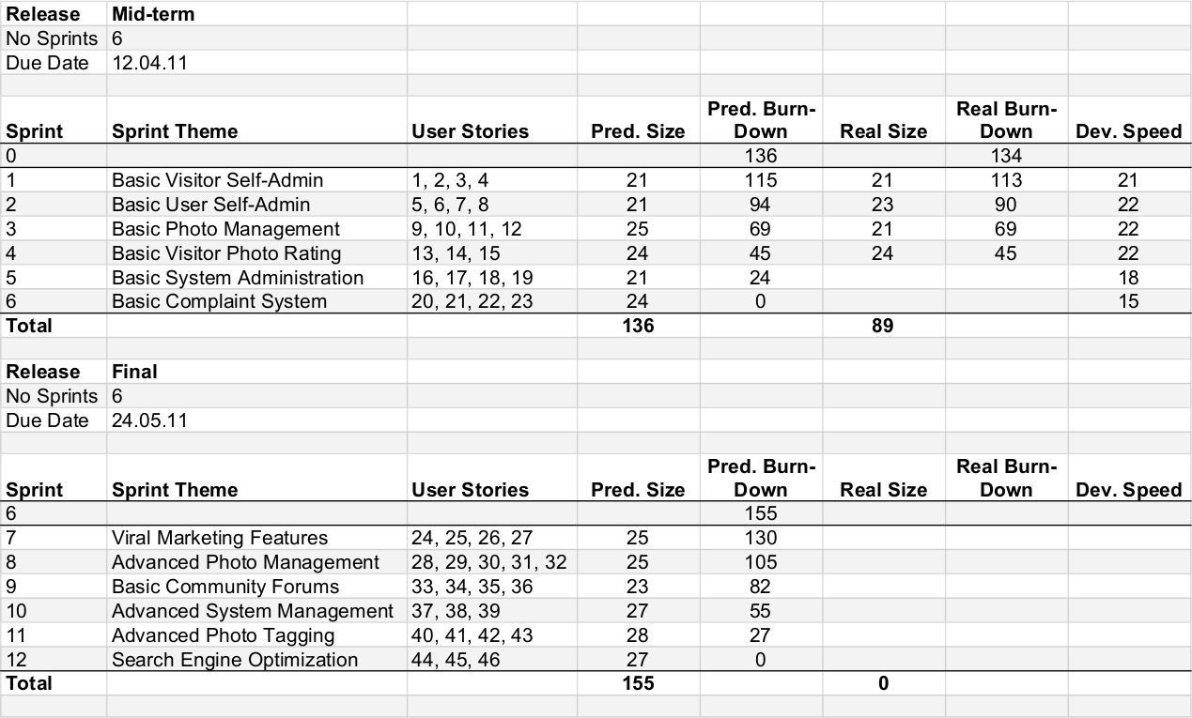
Example Release Plan

Slide 38
Release as Sequence of Sprints
Rel. m-1
Rel. m
Rel. m+1
...
6-12 months
6-12 months
6-12 months
time
Sprint n-1
Sprint n
Sprint n+1
...
...
P
E
3R
P
E
3R
P
E
3R
1-4 weeks
1-4 weeks
1-4 weeks
time

Slide 39
Single Release Plan (Artifact)
Single Release Plan
  Is a product increment for the next market release / customer deployment
  Consists of all product backlog items considered part of that increment
  Structures the release into sprints by theme and purpose
  Is a planning and communication tool, not a strict plan
Other properties
  Evolving: Is adapted in reaction to changes in team and environment

Slide 40
Single Release Planning (Practice)
Plan Single Release
  Responsible: Product owner
  Artifacts: Single release plan
  Collaborators: Market / customer, developers

Slide 41
Example DoD for Product Release
Product release DoD
  Component test coverage is 70% or higher
  Software documentation passes external review
  User manual passes external review
Always expected
  Project builds, deploys, and tests successfully

Slide 42
Track Release Burn-Down
Track Release Burn-down
  Responsible: Product owner
  Artifacts: Release burn-down chart
  Collaborators: None

Slide 43
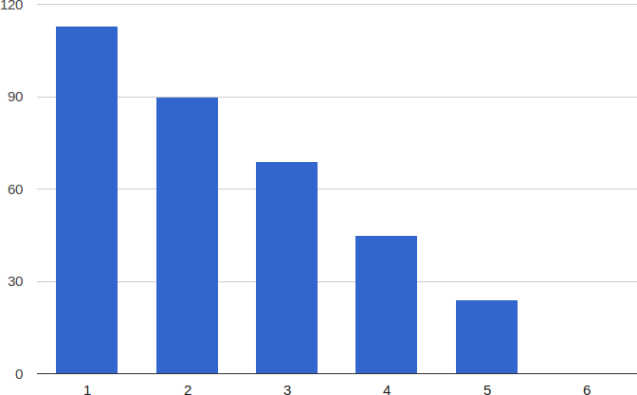
Release Burn-down Chart (Artifact)

Slide 44
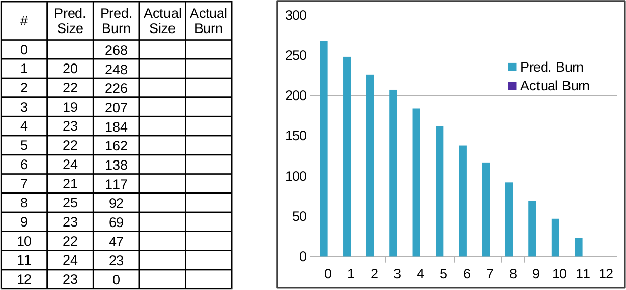
Predicting Burn-down

Slide 45
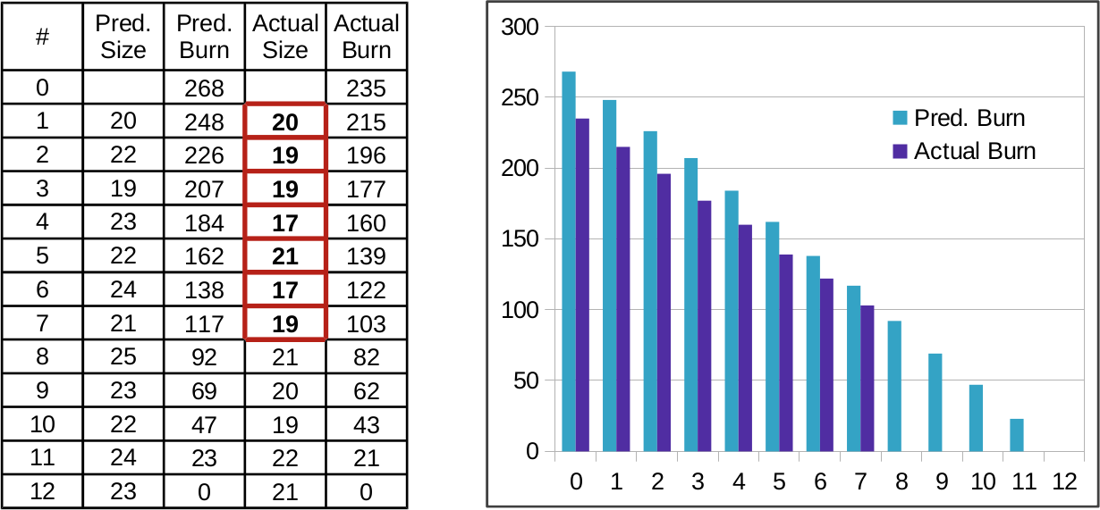
Adjusting Burn-down

Slide 46
6. Roadmapping

Slide 47
Roadmap (Artifact)
External Roadmap
  Overview-oriented; few details are provided
  Serves communication needs
  Serves external stakeholders
Internal Roadmap
  As detail oriented as needed (richer than external roadmap)
  Serves planning and communication needs
  Serves internal stakeholders

Slide 48
Roadmap as Sequence of Releases
External roadmap
...
...
Release 1.3
New functionality
Release 2.0
New architecture
Release 2.1
Major bug fixes
2014-04-01
2014-10-01
2015-04-01
time
...
Rel. m-1
Rel. m
Rel. m+1
...
6-12 months
6-12 months
6-12 months
time
Internal roadmap

Slide 49
Roadmapping (Practice)
Plan Roadmap
  Responsible: Product owner
  Artifacts: Release plan, releases
  Collaborators: Market / customer, funder / sponsor
  Note: Not part of Scrum proper

Slide 50
Example Roadmap
Minimal Product
Runs on Linux Stack
Deployable at Cust#1 Site
alpha
+ QA
beta
+ QA
start
alpha
beta
GA
2011-07-13
2012-03-30
2012-05-30
2012-07-30
time
Funding
Review
Integrates wazoo
Allows humpling
Runs on Windows
Meets accessibility reqs
Single-click installer
Meets new perf. reqs
Dingsbums compatible
v2.2
CES
v2.3
v2.4
CES
2013-01-15
2013-07-15
2014-01-15
time

Slide 51
Vision vs. Roadmap vs. Release
 | Timeframe | Content | Certainty | Owner
Product Vision | Long-term (3+ years) | High-level ideas | Low | CEO
Product Roadmap | Medium (1-5 years) | Themes and epics | Medium | Strategic product manager
Product Release | Short-term (months) | Epics and features | High | Technical product manager

Slide 52
Planning by Organizational Scope
Roadmapping
Annual goals
Annual goals
time scope
Release planning
Quarterly
goals
Quarterly
goals
Sprint planning
Team / Product
Department / Portfolio
Company
Organizational Scope

Slide 53
Review / Summary of Session
Planning horizons
Definition of done
Types of sprints
Sprint planning
Release planning
Roadmapping

Slide 54
Thank you! Questions?
dirk.riehle@fau.de – https://oss.cs.fau.dedirk@riehle.org – https://dirkriehle.com – @dirkriehle
DR

Slide 55
Legal Notices
License
  Licensed under the CC BY 4.0 International license
Copyright
  © 2010-2022 Dirk Riehle, some rights reserved

